Slide 1


Blended intensive programme – Introduction to OpenSim
Basilio Goncalves & Hans Kainz

Slide 2

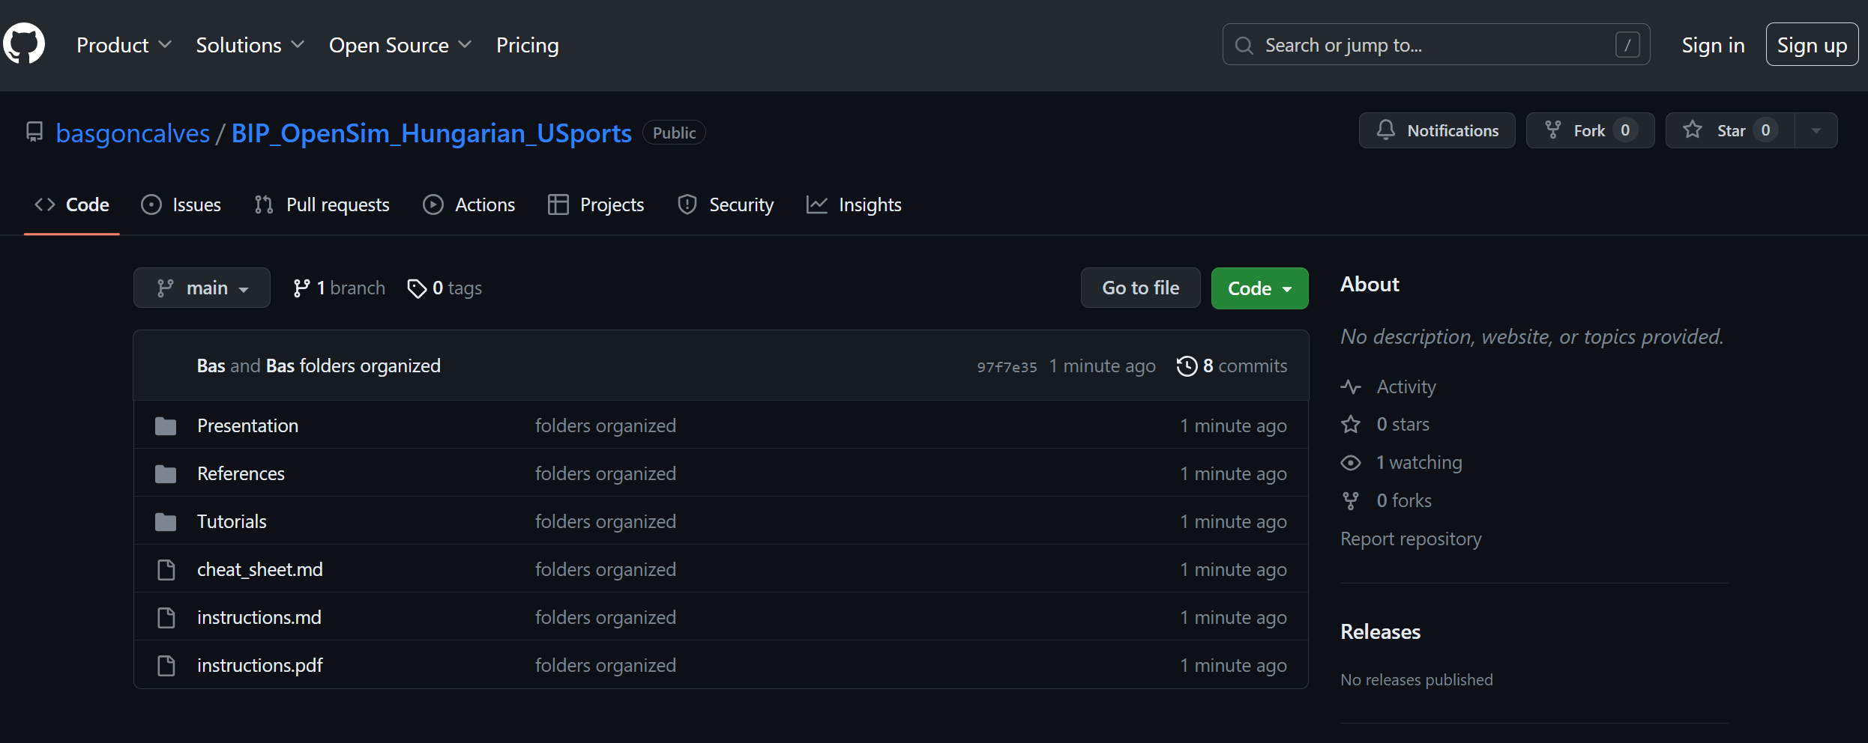
https://github.com/basgoncalves/BIP_OpenSim_Hungarian_USports
Notes:
https://github.com/basgoncalves/BIP_OpenSim_Hungarian_USports

Slide 3
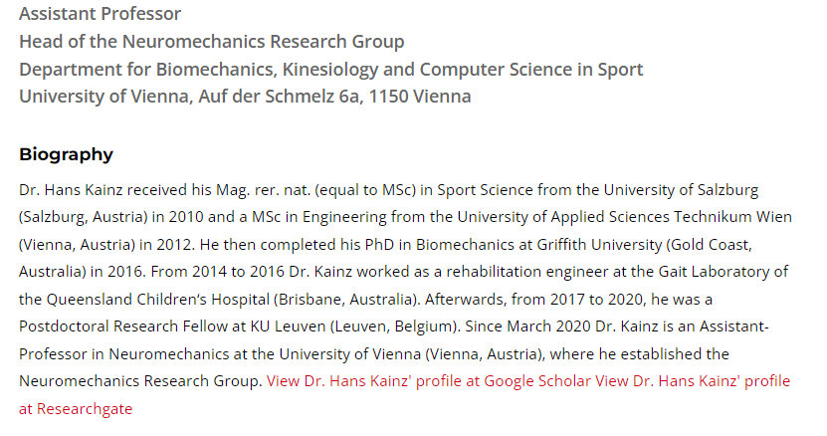
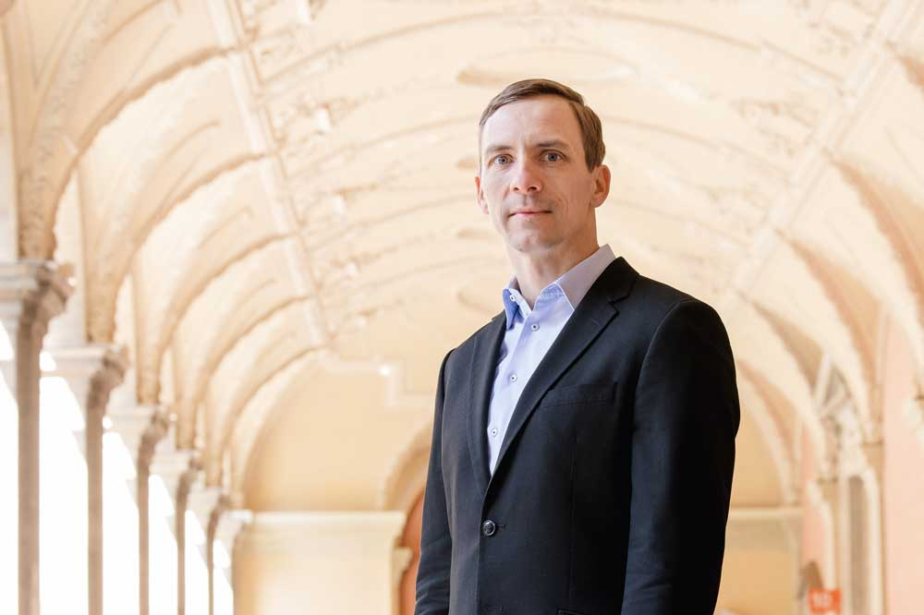
Hans
Who are we?

Slide 4
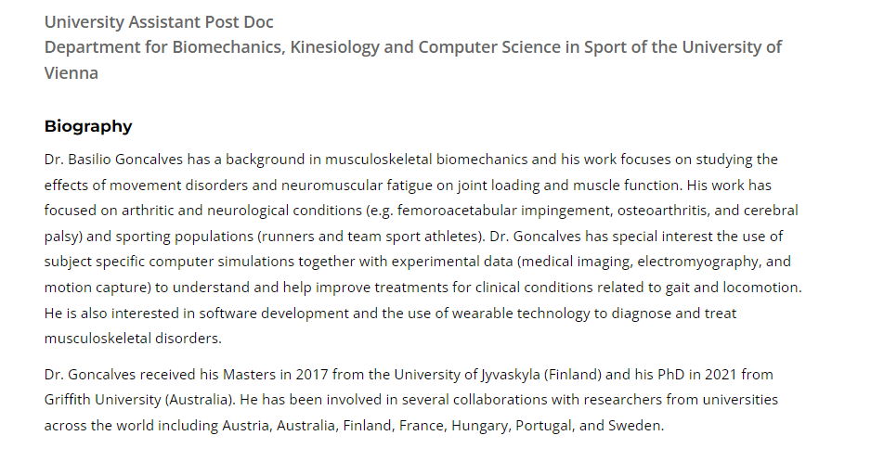

Bas
Who are we?

Slide 5
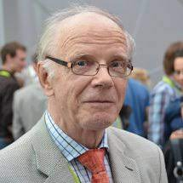
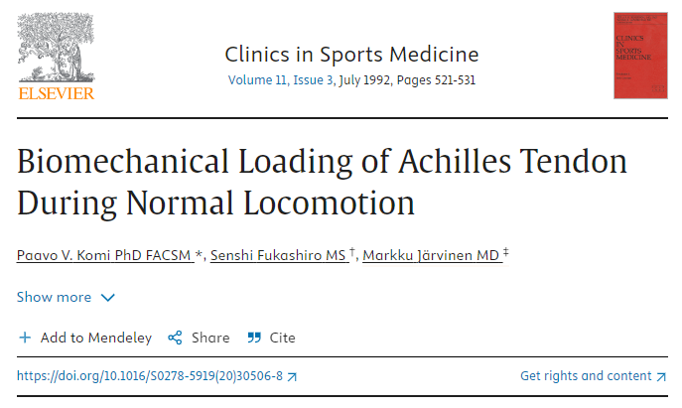
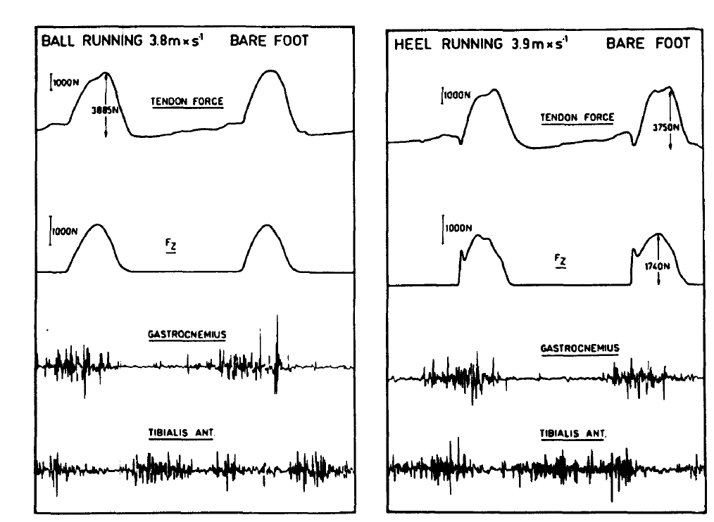
Why do we care?
Notes:
https://www.sciencedirect.com/science/article/abs/pii/S0278591920305068

Slide 6
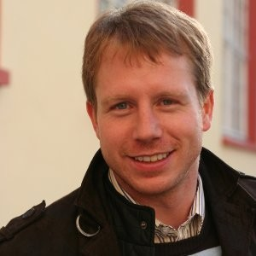
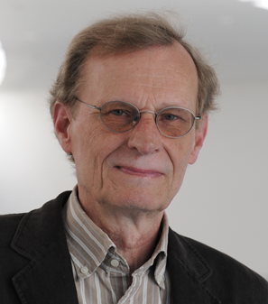
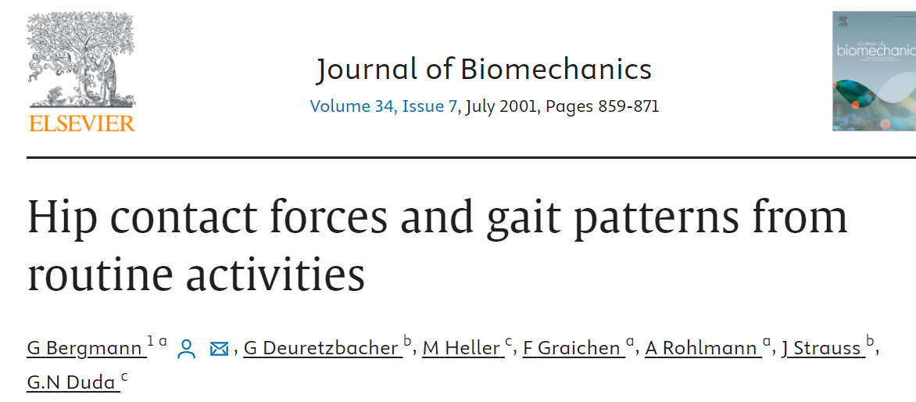
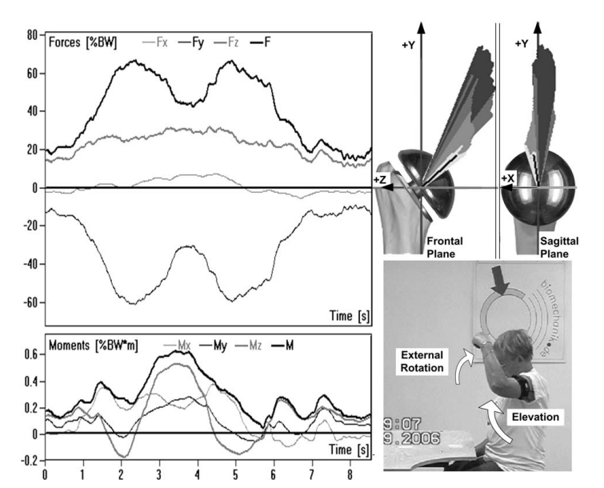
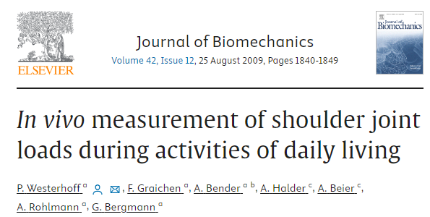
Why do we care?
Notes:
https://www.sciencedirect.com/science/article/abs/pii/S0021929009003169?via%3Dihub
https://www.sciencedirect.com/science/article/abs/pii/S0021929001000409?via%3Dihub

Slide 7
Main problems with in-vivo measurements
Why do we care?
Invasive
Cannot measure more than one muscle group
May alter individuals movement patters

Slide 8


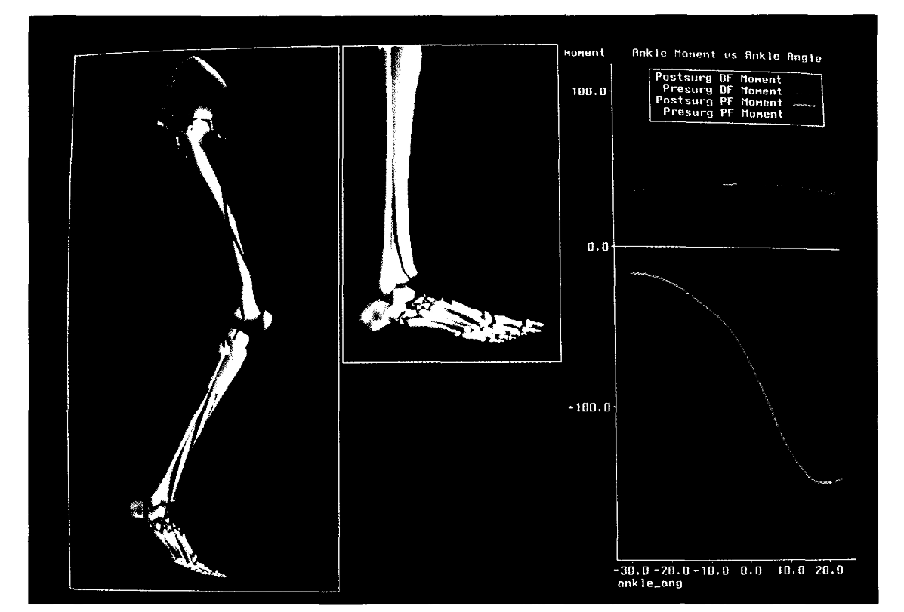
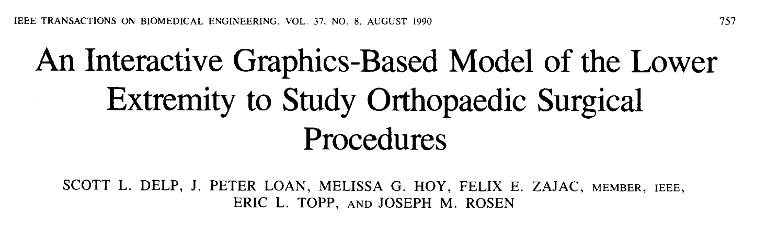
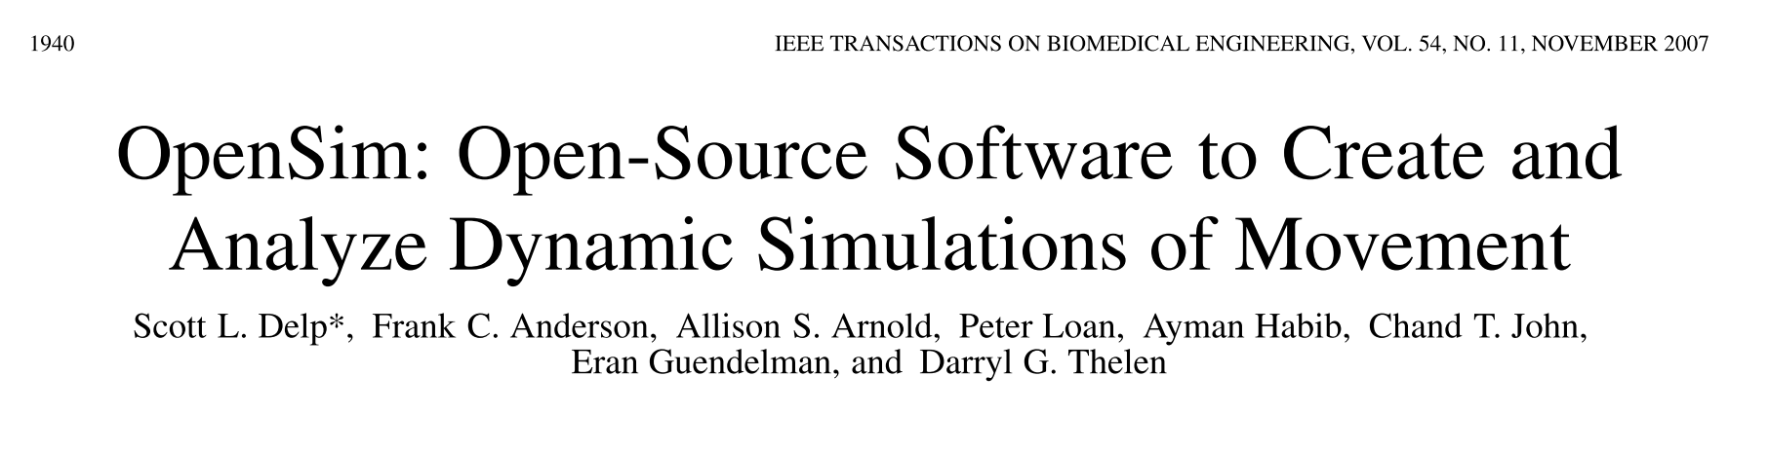

Slide 9
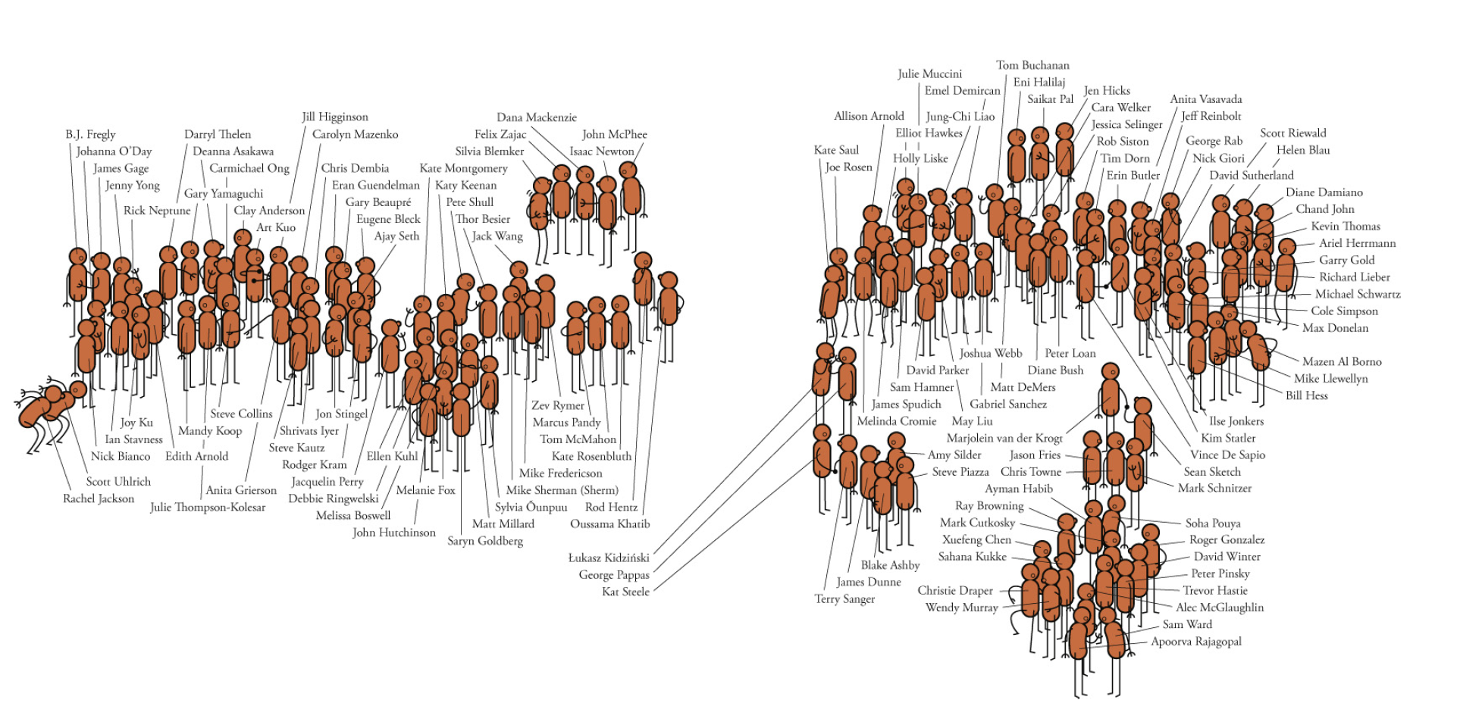

Slide 10
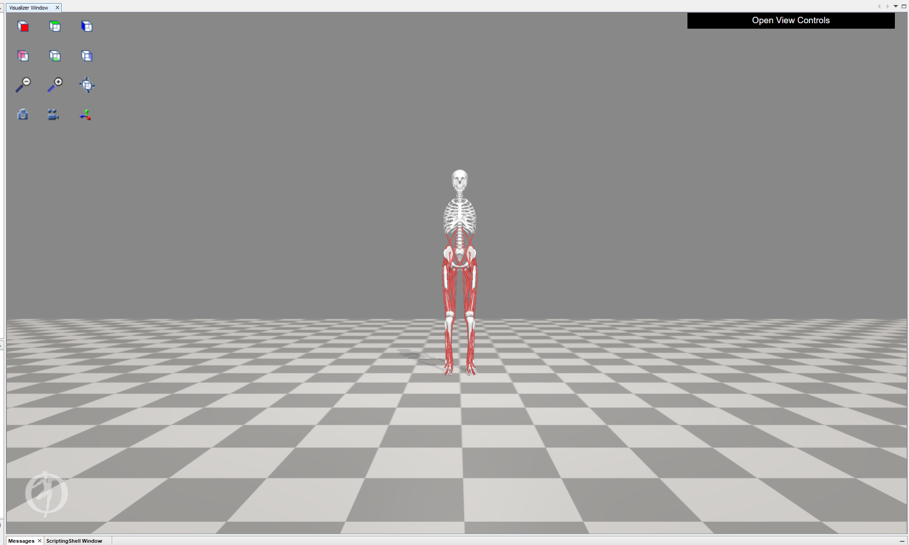

Slide 11
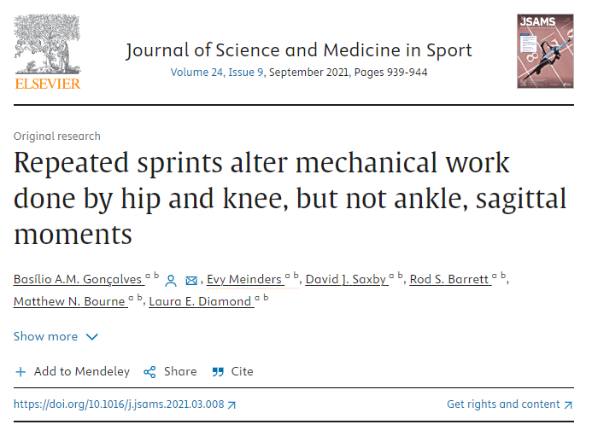
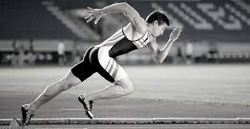
How has it been used?

Slide 12
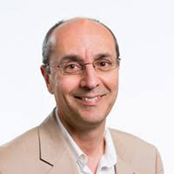
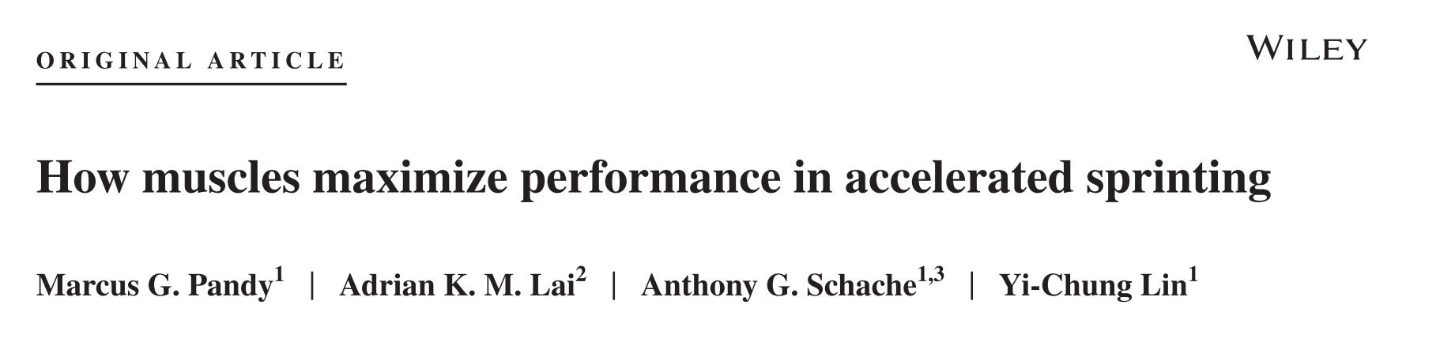
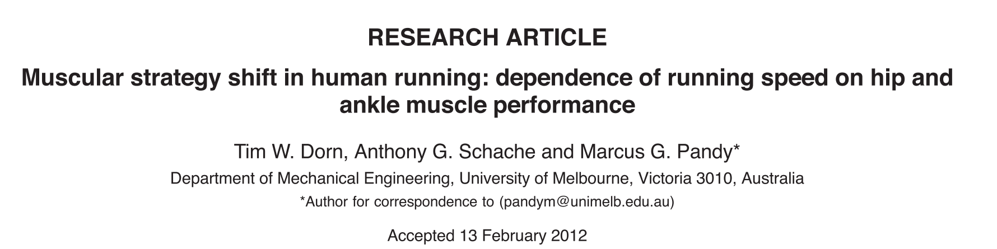
How has it been used?

Slide 13
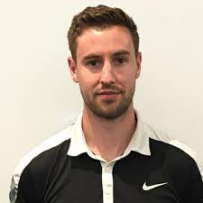
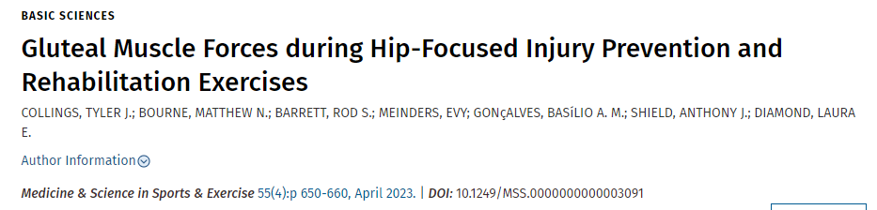
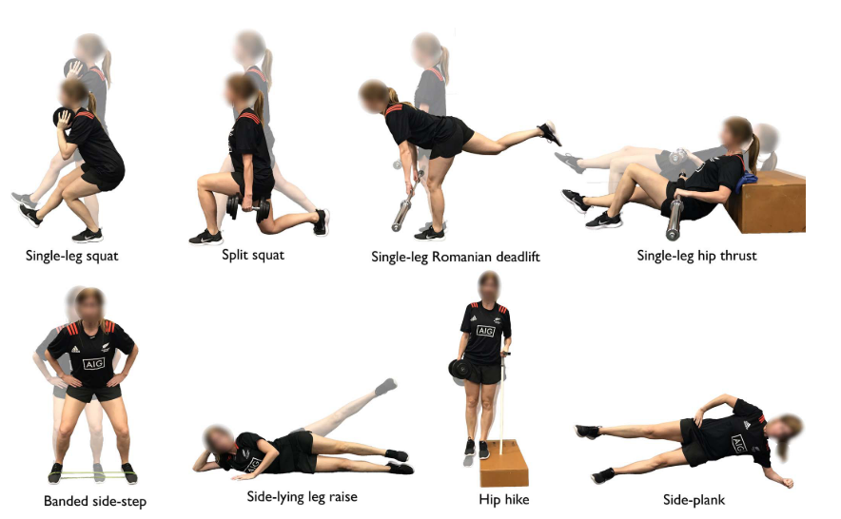
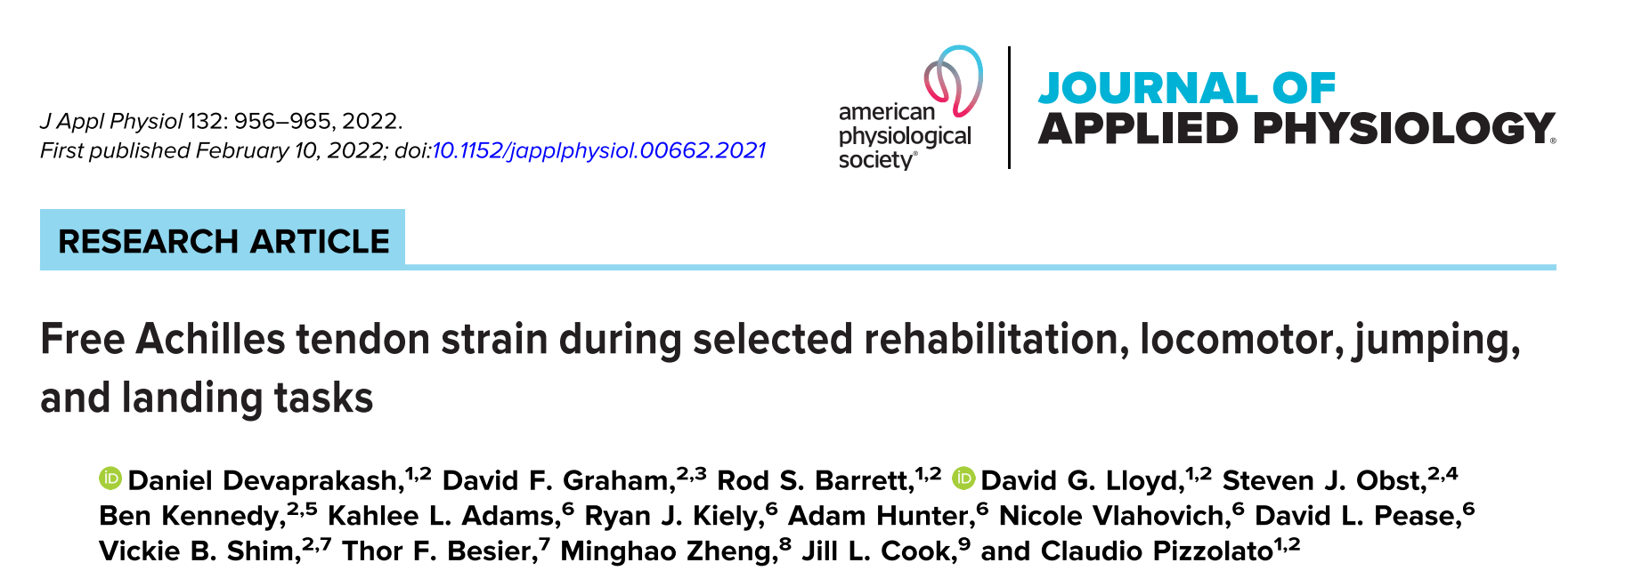
How has it been used?

Slide 14
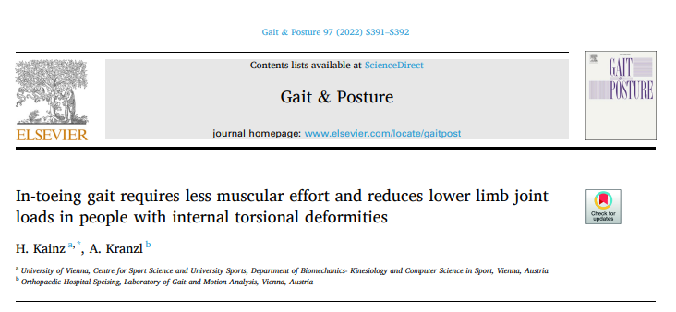
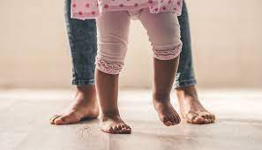
How has it been used?

Slide 15

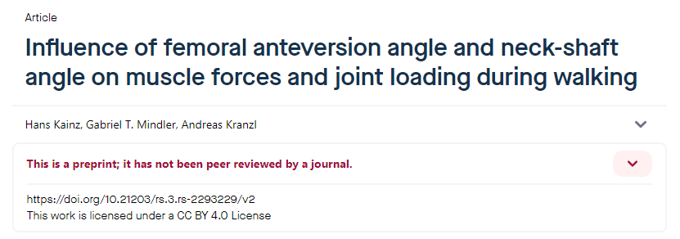
How has it been used?

Slide 16
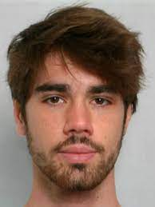
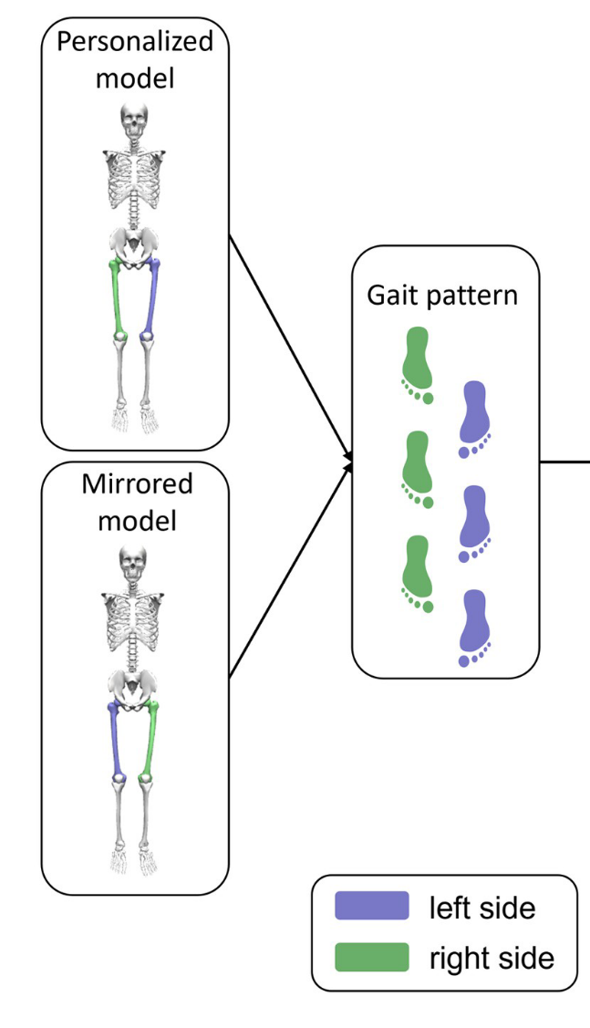
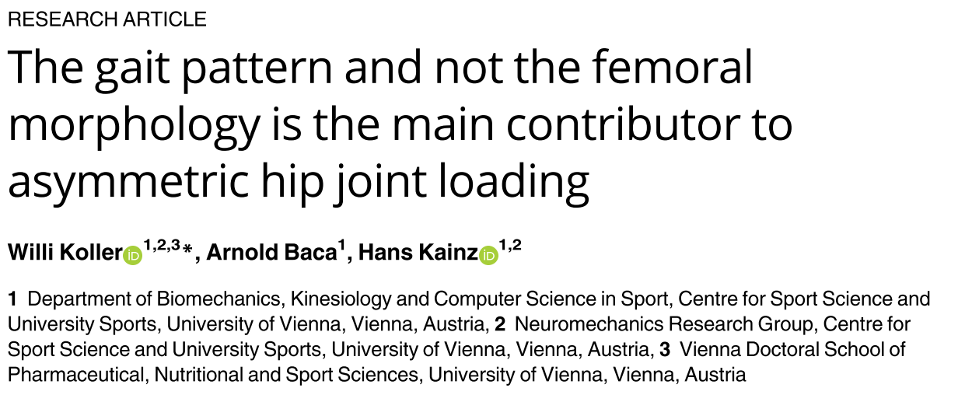
How has it been used?
Notes:
https://journals.plos.org/plosone/article?id=10.1371/journal.pone.0291789

Slide 17
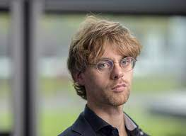

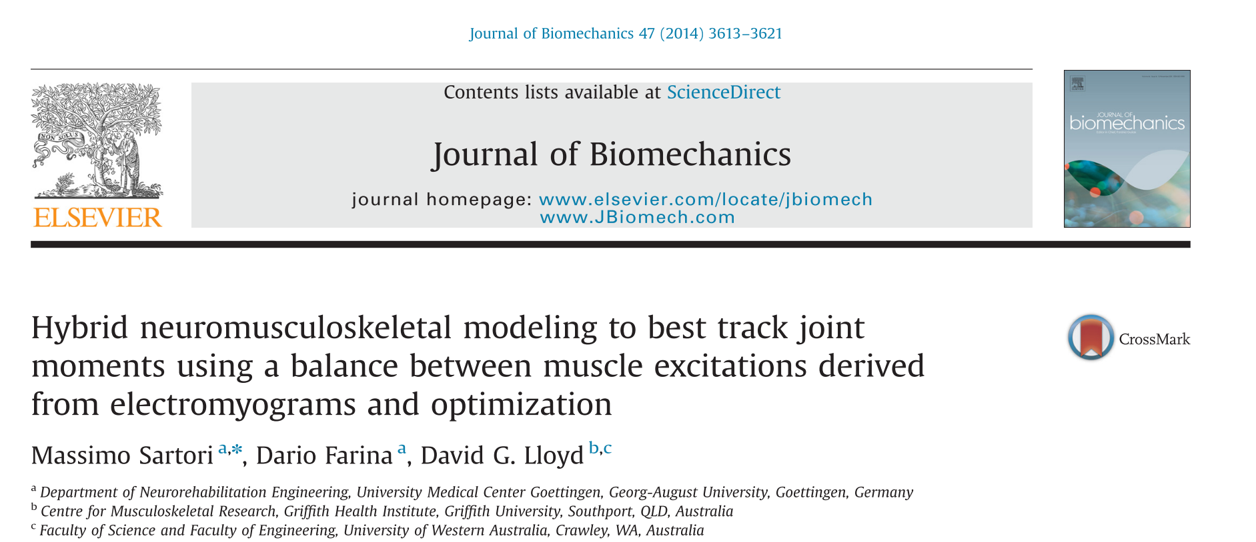
How has it been used?
Notes:
10.1016/j.jbiomech.2014.10.009

Slide 18
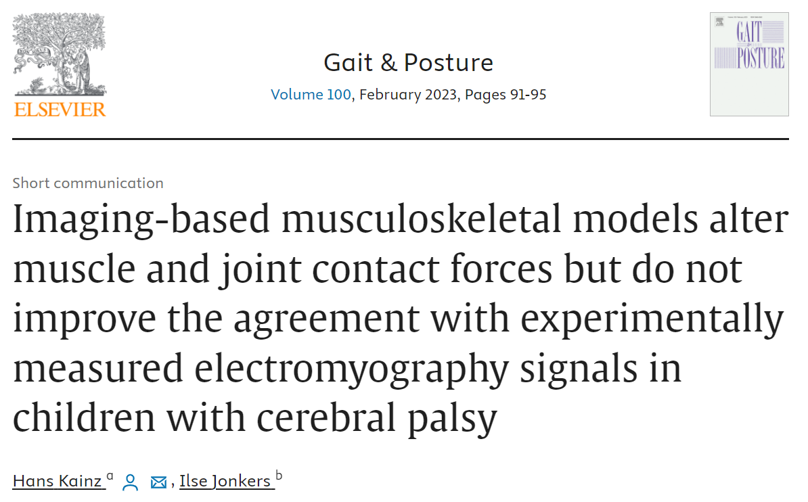
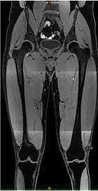
How has it been used?
Notes:
https://www.sciencedirect.com/science/article/abs/pii/S0966636222006567

Slide 19


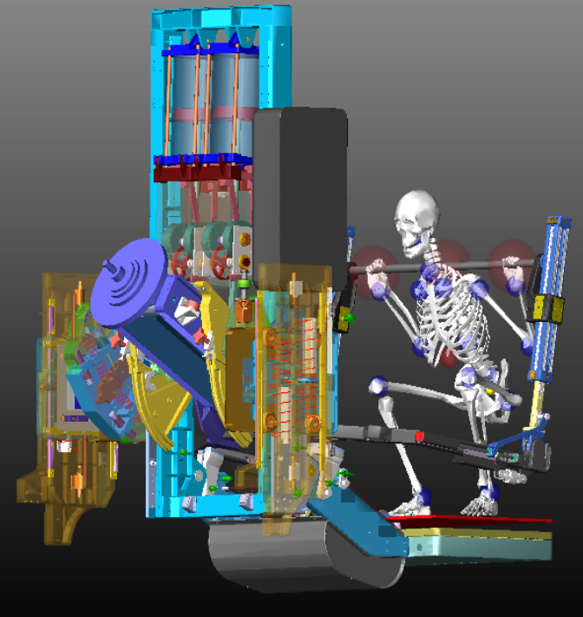
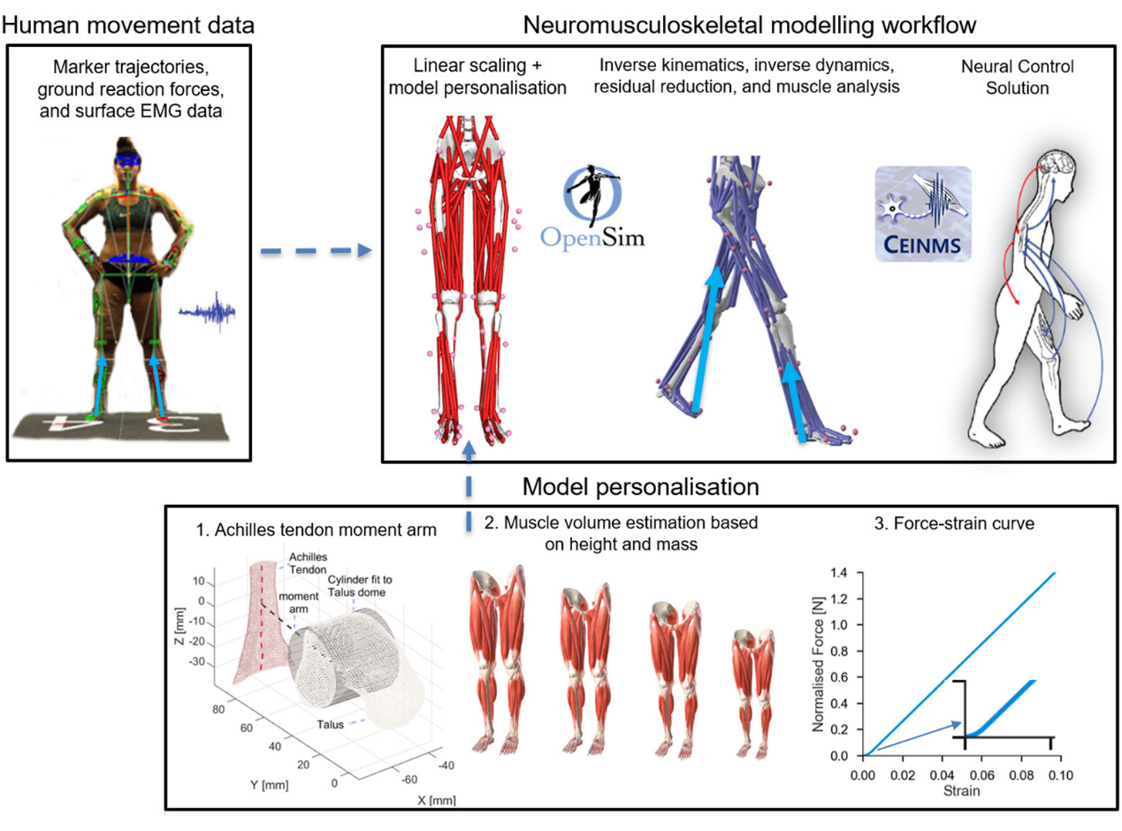
How has it been used?
Digital astronaut
Digital athlete
Notes:
https://www.nasa.gov/general/digital-astronaut-simulation-tool/
10.1152/japplphysiol.00662.2021

Slide 20
Modeling in opensim
Introduction to rigid body and muscle-tendon modelling;
The inverse problem
Model components
Input files
Available tools

Slide 21
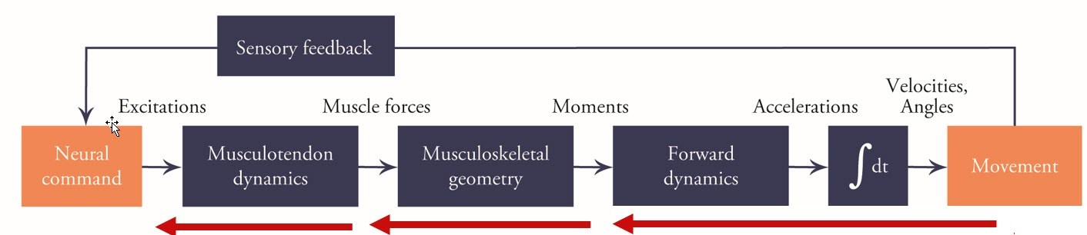
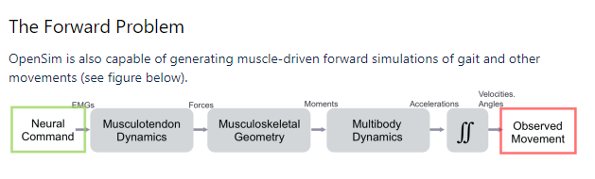
Inverse vs forward simulations
Introduction to rigid body and muscle-tendon modelling;

Slide 22
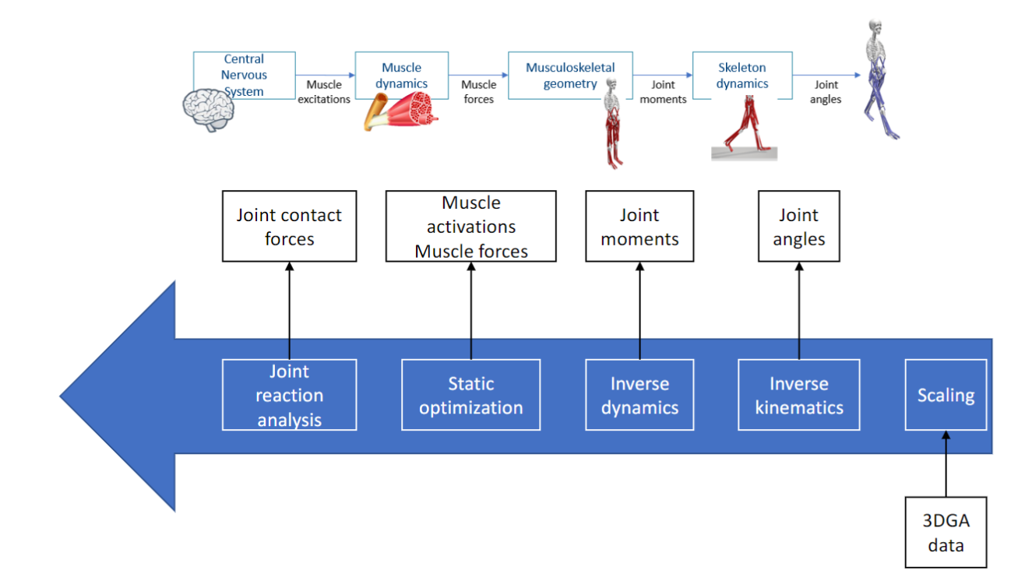
Inverse approach
Introduction to rigid body and muscle-tendon modelling;

Slide 23
What is a musculoskeletal model?
Introduction to rigid body and muscle-tendon modelling;
Rigid bodies
Connected by joints
Restricted by constrains
Actuated by muscles-tendon units
Informed by experimental data

Slide 24

Time to practice (use the folder “Hello_world_of_simulations”)
Introduction to rigid body and muscle-tendon modelling;
https://github.com/basgoncalves/BIP_OpenSim_Hungarian_USports

Slide 25
Questions
Introduction to rigid body and muscle-tendon modelling;
What are the components of a model?
How can a model be edited? (GUI, text editor, scripting)
How many bodies does this model have?
How many muscles does this model have in each leg?
What is the maximum isometric force of recfem?
How many DOF do the hip and knee joint have?
How heavy is the tibia segment?
Load experimental markers. Why are the markers doing a moon walk?
Load experimental GRF. Why are the forces not below the feet markers?

Slide 26
File types
Introduction to rigid body and muscle-tendon modelling;
.c3d - exported by most Gait Analysis laboratories
.trc – markers
.mot – motion files
.sto – storage files (results from analysis)
.xml – setup files
.osim – opensim models

Slide 27
Time to practice (practice plotting and explore files)
Introduction to rigid body and muscle-tendon modelling;
https://github.com/basgoncalves/BIP_OpenSim_Hungarian_USports

Slide 28
Questions
Introduction to rigid body and muscle-tendon modelling;
What is the maximum moment arm of psoas during hip_flexion_r?
Why are moment arms negative?
Plot the mtu length of the psoas_r during hip_flexion_r. Explain the figure.
Plot mtu length of lat_gas_r and bflh_r during hip flexion. Why are they so different?
Plot active, passive, and total-fiber force.

Slide 29
Break (10-15 min)
Introduction to rigid body and muscle-tendon modelling;

Slide 30
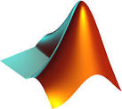

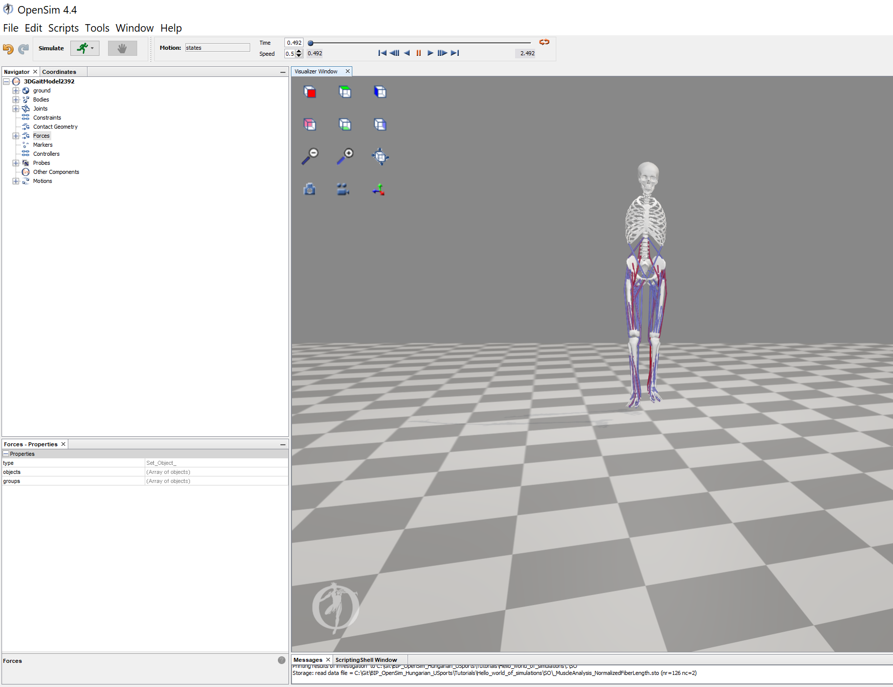
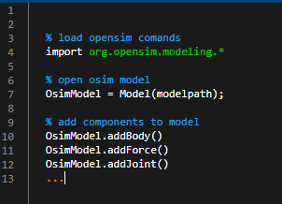
GUI vs CMD
Introduction to rigid body and muscle-tendon modelling;
C:\Users\Biomech\Documents\OpenSim\4.4\Code
https://simtk.org/api_docs/opensim/api_docs/

Slide 31
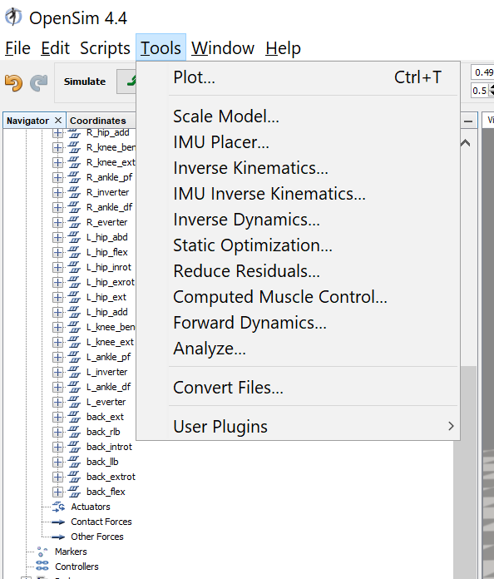
Run your first simulations

Slide 32
Time to practice (perform all analysis and plot results)
Introduction to rigid body and muscle-tendon modelling;
https://github.com/basgoncalves/BIP_OpenSim_Hungarian_USports

Slide 33
Questions
Introduction to rigid body and muscle-tendon modelling;
- What are the range of marker errors during the inverse kinematics step?
What are the peak hip, knee, and ankle angles?
What are the peak sagittal joint moments hip, knee, and ankle?
What are the lat_gas and rect_fem peak forces and activation?
What are the mtu lengths for bflh_r and soleus_r.
What are the maximum reserves moments hip_flexion_r, hip_adduction_r, hip_rotation_r, knee_angle_r, ankle_angle_r
How is the peak vertical component of hip contact loads, relative to participants body weight?

Slide 34
External biomechanics
Model personalization, Estimation of joint angles and external joint moments
Scaling
Inverse kinematics
Inverse dynamics
Residual reduction analysis
Muscle analysis

Slide 35
Time to practice (Sprinting)
Introduction to rigid body and muscle-tendon modelling;
https://github.com/basgoncalves/BIP_OpenSim_Hungarian_USports

Slide 36
Questions
Introduction to rigid body and muscle-tendon modelling;
What are the scaling factors of femur_r, tibia_r, and calcn_r.
How is the femur being scaled?
What is the weight of the “C7” marker?
Change the weight

Slide 37
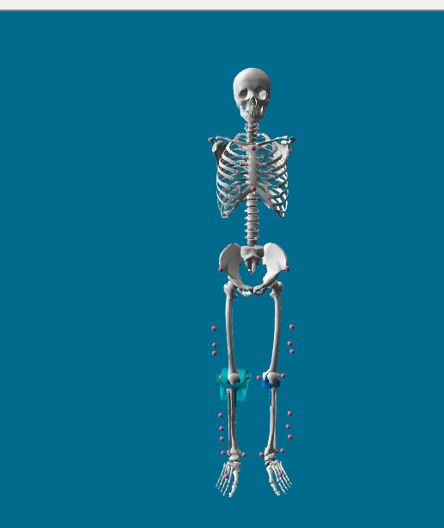
Scaling problems
Model personalization, Estimation of joint angles and external joint moments
Marker position
Marker weights
Check marker errors

Slide 38
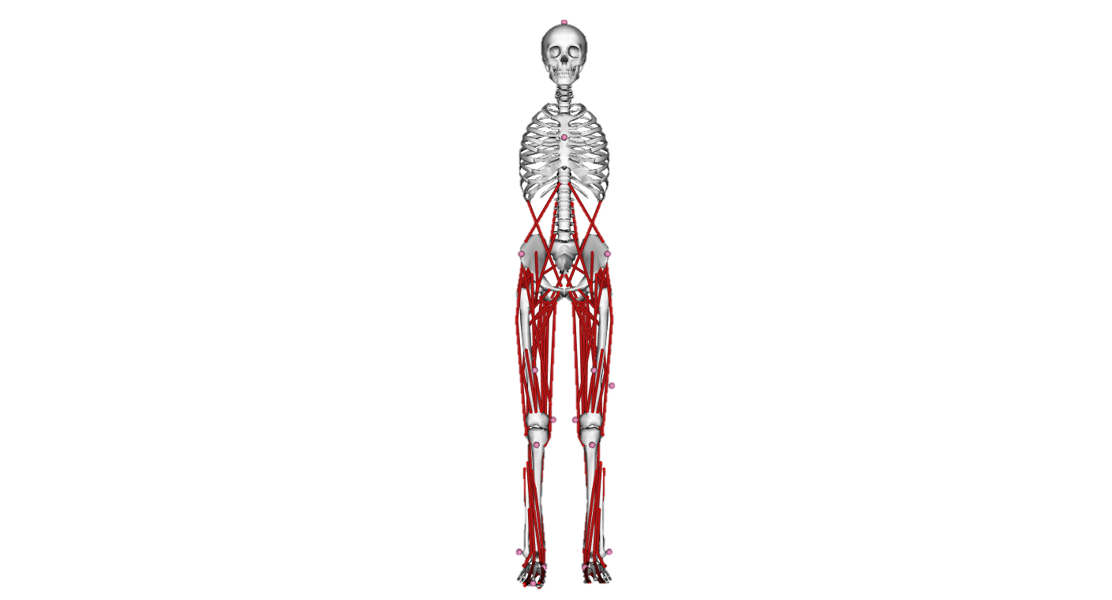


Why scaling?
Generic model

Slide 39
Why scaling?
Generic model

Slide 40
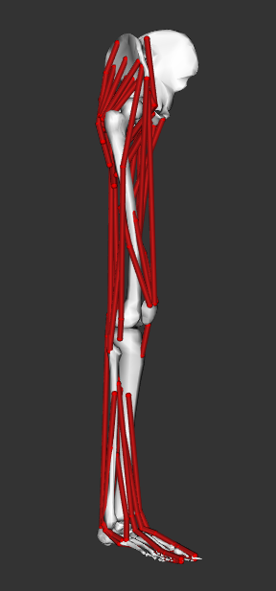
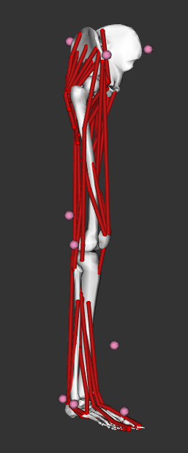
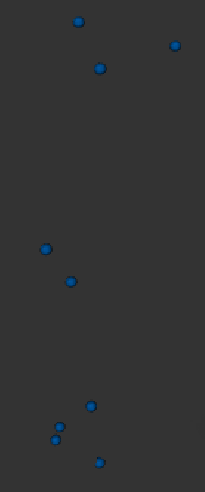
Scaling
Model + model markers
Experimental markers
Generic model

Slide 41


Definition of scale factors
Measurement-based scaling
Manual scaling
specified by the user based on some predetermined measure
e.g. anthropometric measurements
Generic model
Scaled model
Experimental markers
Model markers

Slide 42

Adjust model markers
adjusts the model markers to match the experimental markers at the static pose
Experimental markers
Model markers

Slide 43

Scaled model
Experimental markers
Model markers

Slide 44

Hints
Scaling can have a big impact on your simulation results
Use joint centers for scaling in participants with movement disorders

Slide 45


Direct Kinematics (DK)
Markers are rigidly attached to bones
Davis, 1988
Kadaba et al., 1989
Kadaba et al., 1990
Notes:
In Direct Kinematics it is assumed that the markers are rigidly attached to the bones. That means that it is assumed that no movements occur between the surface markers and the underlying bones. However, we know that this is not the case. If a person moves, soft tissue artefacts due to the movement of body segments and muscle contractions, change the position of the surface markers relative to the underlying bones.
The blue circles in this figure represent surface markers. The green circles represent joint centres which are also known as virtual markers.
Let’s assume that there is a lot of soft tissue artefacts at the shank segment and see what happens.

Slide 46
Direct Kinematics (DK)
Markers are rigidly attached to bones
Davis, 1988
Kadaba et al., 1989
Kadaba et al., 1990
Notes:
That’s a lot more soft tissue artefacts than in reality occurs but I want to show you what happens to the underlying skeletal model.

Slide 47
Direct Kinematics (DK)
Markers are rigidly attached to bones
Bone can change length
Davis, 1988
Kadaba et al., 1989
Kadaba et al., 1990
Notes:
Either it changes the segment lengths, in this case the shank segment.

Slide 48
Direct Kinematics (DK)
Markers are rigidly attached to bones
Bone can change length
Davis, 1988
Kadaba et al., 1989
Kadaba et al., 1990
Notes:
Or

Slide 49
Direct Kinematics (DK)
Markers are rigidly attached to bones
Bone can change length
Joints can fly apart
Davis, 1988
Kadaba et al., 1989
Kadaba et al., 1990
Notes:
It changes the position of the segment. That means the joints can fly apart. Neither, the change in bone length nor the change of the relative position of the segment is physiological correct. That’s one of the biggest drawbacks of Direct Kinematic approaches.

Slide 50

MSK modeling
Static calibration trial
Scaling
Scaled anatomical model
Dynamic walking trials
Inverse Kinematics
Joint angles
Inverse Dynamics
Joint moments
Muscle moment arms
Muscle-tendon lengths
Muscle forces, etc
Musculoskeletal analyses
Delp et al., 2007

Slide 51
Inverse kinematics (IK)
Experimental markers
Model markers
Notes:
Let’s play the same game as before and assume we have a participant with a lot of soft tissue and the markers are moving relative to the underlying bone. On the first picture here we can see the perfect case. All the model markers perfectly match the experimental markers. That’s the reason why we only see the model markers on this figure. The experimental markers are underneath the red model markers.

Slide 52
Inverse kinematics (IK)
Experimental markers
Model markers
Notes:
Let’s assume the experimental markers of the shank segment are a lot more distal compared to the model markers of the shank. Same initial situation as we had before when we were looking at the Direct Kinematics approach.

Slide 53
Inverse kinematics (IK)
Markers are NOT rigidly attached to bones
Fixed bone length
Constrained joint movements
Experimental markers
Model markers
Notes:
Inverse Kinematics changes the pose of the model, without changing the segment lengths or allowing the joints to fly apart, to match the position of the experimental markers as good as possible.
Let’s summarize the Inverse Kinematics approach again:
It is NOT assumed that the markers are rigidly attached to the bones but we have a rigid generic model, which does not allow changes in bone lengths after scaling. Furthermore, joint movements are constrained which prevents un-physiological joint movements.

Slide 54
Time to practice (inverse kinematics with different settings)
Introduction to rigid body and muscle-tendon modelling;
https://github.com/basgoncalves/BIP_OpenSim_Hungarian_USports

Slide 55
Questions
Introduction to rigid body and muscle-tendon modelling;
How do marker weights change scale factors?
What are, approximately, total, RMS, and maximum marker errors, after inverse kinematics?
Plot hip, knee, and ankle angles
What is the peak hip flexion angle during sprinting?
What is the peak knee flexion angle during sprinting?
What is the peak ankle plantarflexion angle during sprinting?
How can you increase the trust on your results?

Slide 56

Torque (τ)/Moment (M)
Introduction to rigid body and muscle-tendon modelling;
The tendency of a load to produce a rotation (not a translation!)
τ or M is the cross product of the
Applied force (F)
Moment arm (r): shortest distance between the line of force and the axis of rotation
M = F × r

Slide 57

Torque (τ)/Moment (M)
Introduction to rigid body and muscle-tendon modelling;

Slide 58
Time to practice (inverse dynamics)
Introduction to rigid body and muscle-tendon modelling;
https://github.com/basgoncalves/BIP_OpenSim_Hungarian_USports

Slide 59
Questions
Introduction to rigid body and muscle-tendon modelling;
How much is the peak grf relative to participant bodyweight?
What are the peak plantar flexion moment?
Why is the left ankle moment so much smaller compared with right?

Slide 60
Questions
Introduction to rigid body and muscle-tendon modelling;
What are the peak plantar flexion moment?
Why is the left ankle moment so much smaller compared with right?

Slide 61

Set-up files matter
Introduction to rigid body and muscle-tendon modelling;

Slide 62
Questions
Introduction to rigid body and muscle-tendon modelling;
What are the peak plantar flexion moment?
Why is the left ankle moment so much smaller compared with right?

Slide 63


Residual reduction analysis
Introduction to rigid body and muscle-tendon modelling;

Slide 64

Residual reduction analysis
Introduction to rigid body and muscle-tendon modelling;

Slide 65

Residual reduction analysis
Introduction to rigid body and muscle-tendon modelling;

Slide 66


Residual reduction analysis
Introduction to rigid body and muscle-tendon modelling;
Measured kinematics
Optimised kinematics
Optimised moments
Measured moments

Slide 67
Time to practice (residual reduction analysis)
Introduction to rigid body and muscle-tendon modelling;
https://github.com/basgoncalves/BIP_OpenSim_Hungarian_USports

Slide 68
Questions
Introduction to rigid body and muscle-tendon modelling;
What are the scaling factors of femur_r, tibia_r, and calcn_r.
How is the femur being scaled?
What is the weight of the “C7” marker?
Change the weight

Slide 69
Muscle forces in openSim
Estimation of muscle and joint contact forces
Garbage in garbage out
Check the inputs
Moment arm

Slide 70

Forces / muscle mechanics
Optimal fibre length
Tendon slack length
Maximum isometric force
Pennation angle at optimal fibre length
Maximum contraction velocity

Slide 71

Muscle moment arms
Estimation of muscle and joint contact forces

Slide 72
Muscle moment arms
Estimation of muscle and joint contact forces

Slide 73
Theroy muscle and static opt
Estimation of muscle and joint contact forces

Slide 74
Time to practice (static optimisation)
Introduction to rigid body and muscle-tendon modelling;
https://github.com/basgoncalves/BIP_OpenSim_Hungarian_USports

Slide 75
Questions about the muscle forces
Estimation of muscle and joint contact forces

Slide 76

Calculations joint contact forces
Estimation of muscle and joint contact forces
Parent or child
Body orientations

Slide 77
Effects of surgery transfer
Simulate the effects of musculoskeletal alterations on muscle and joint loads
#

Slide 78
Muscle and joint loading during running
Simulate the effects of musculoskeletal alterations on muscle and joint loads
#

Slide 79
Effects of bone geometry on joint loading
Simulate the effects of musculoskeletal alterations on muscle and joint loads
TD01 and P01

Slide 80
Musculoskeletal (MSK) modeling
Summary and future directions
Data collection
Traditional gait analysis
Advantages of MSK modeling
What is a MSK model?

Slide 81
Musculoskeletal (MSK) modeling
Summary and future directions
Data collection
Traditional gait analysis
Advantages of MSK modeling
What is a MSK model?

